Slide 1
Human ancestors

Slide 2
Syllabus dot point
Determining relatedness and possible evolutionary pathways for hominids uses evidence from comparisons of modern humans and the great apes with fossils of: ▪ Australopithecus afarensis ▪ Australopithecus africanus ▪ Paranthropus robustus ▪ Homo habilis ▪ Homo erectus ▪ Homo neanderthalensis ▪ Homo sapiens

Slide 3
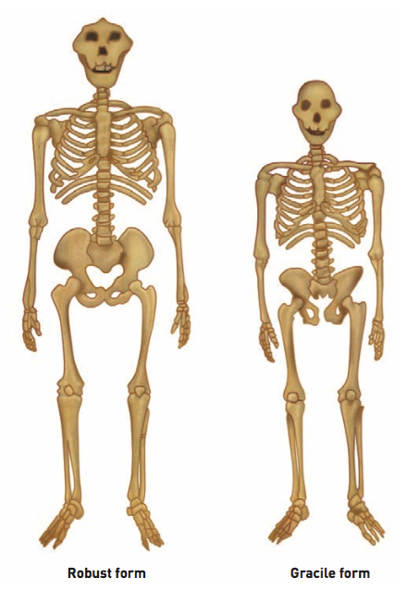
Australopithecines
Paranthropus robustus and Australopithecus afarensis are both very similar species of Australopithecines
Some key anatomical differences - two main variations
a gracile (slender) body shape
robust (heavier) body shape
Paranthropus robustus is an example of a robust form.
Australopithecus afarensis is an example of a gracile form.

Slide 4
Australopithecus afarensis
“Lucy”
40% skeletal remains discovered in Hadar, Ethiopia
Approximately 3-3.6 million years old
Gracile form
Ape-like features - flat nose, a strongly projecting lower jaw
Cranial capacity 500 cc - 1/3 the size of a modern human brain
Long, strong arms with curved fingers adapted for climbing trees
Small canine teeth like all other early humans, and a body that stood on two legs and regularly walked upright

Slide 5
Australopithecus africanus
Approximately 3.2 - 2 million years old
Fossil discovery in 1924 – “Taung Child”
Australian anatomist, Raymond Dart named the fossil Au. Africanus
Had a rounder cranium, larger brain and smaller teeth
Relatively long arms and a strongly sloping face that juts out from underneath the braincase with a pronounced jaw (ape-like features)
Anatomically similar to Au. Afarensis
Pelvis, femur (upper leg), and foot bones of Au. africanus indicate that it walked bipedally
Shoulder and hand bones indicate they were also adapted for climbing

Slide 6
Paranthropus robustus
Approximately 1.8 – 1.2 million years ago
Large megadont cheek teeth with thick enamel
Focused their chewing in the back of the jaw.
Large zygomatic arches (cheek bones) allowed the passage of large chewing muscles to the jaw
Sagittal crest provided a large area to anchor chewing muscles to the skull
Robust form

Slide 7
Homo habilis
“Handy Man”
First species to make tools
Fossils discovered in Olduvai Gorge 1964
Taller, with longer femurs
Larger brain
Smaller teeth – change in diet (meat) → increase in brain size
Bulge in speech-producing area of brain - development of language
May have existed alongside P. robustus (fossils found in same area)
Hands were more robust compared H. sapiens – tree-climbing prominent

Slide 8
Homo erectus
Larger brain than H. habilis
First discovered in Asia
Earlier forms of the species found in Africa - Homo ergaster
Footprints found in Africa – big toe was parallel to other toes
Evidence of fire use – advantages key
Increased group hunting (skillful)
Evidence that the environment was no longer a selective agent on hominins (H. erectus modified their environment)
Expansion of areas occupied
Building shelters
Tool and fire use

Slide 9
Homo neanderthalensis
Discovered 1856 – Neander Valley, Düsseldorf Germany
More developed anatomically and culturally than H. erectus
Cranial capacity 1485 cm³
Heavy brow ridges remain
Probable that Neanderthals and sapiens lived alongside each other
Reason for Neanderthal extinction is unknown
H. sapiens outcompeted directly – in combat
Indirectly – hunting and gathering the same resources

Slide 10
Homo sapiens
“Cro-Magnon”
Earliest discovery – Europe
Been around for about 200 000 years before present
Cranial capacity: 1350 cm³
Flatter faces, larger cranial capacity, reduced or absent brow ridges, no sagittal crest, smaller teeth, broader hips, longer femurs which slope towards the knee

